Slide 1
INTRODUCTION TO MANAGEMENT
Submitted by- Mrs. Reena Rani

Slide 2
What is Management?
Management is getting things done through others. The job of management is not only to provide dynamic leadership, but also to exercise a positive influence to make the future events favourable for the enterprise.
Definition of Management: The art of getting things done through the people organized in formal groups is called management.

Slide 3
What is the need of management?
Management is the real force behind production. The success of an organization largely depends upon management.
Tough competition in the market
Production efficiency
Industrial peace
Limited financial resources
Expansion of industries
Complexity of industries

Slide 4
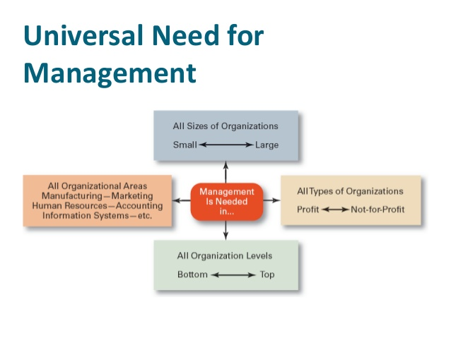

Slide 5
Characteristics of Management
Management is a purposeful activity
Management is social process
Management is associated with the efforts of a group
Management is an integrating process
Management is an intangible force
Management is an universal activity
Management is getting things done
Management is needed at all levels of the organization.

Slide 6
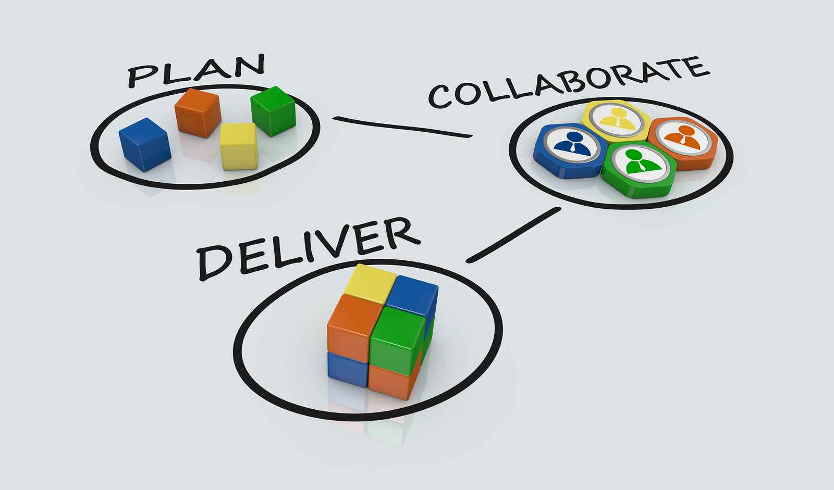

Slide 7
Functions Of Management
The primary organizational objective of an industry may be production, financing and distribution of produced goods.
The management has t perform the following functions:
1 Planning
2 Organising
3 Staffing
4 Co-ordinating
5 Directing
6 Motivating
7 Controlling

Slide 8
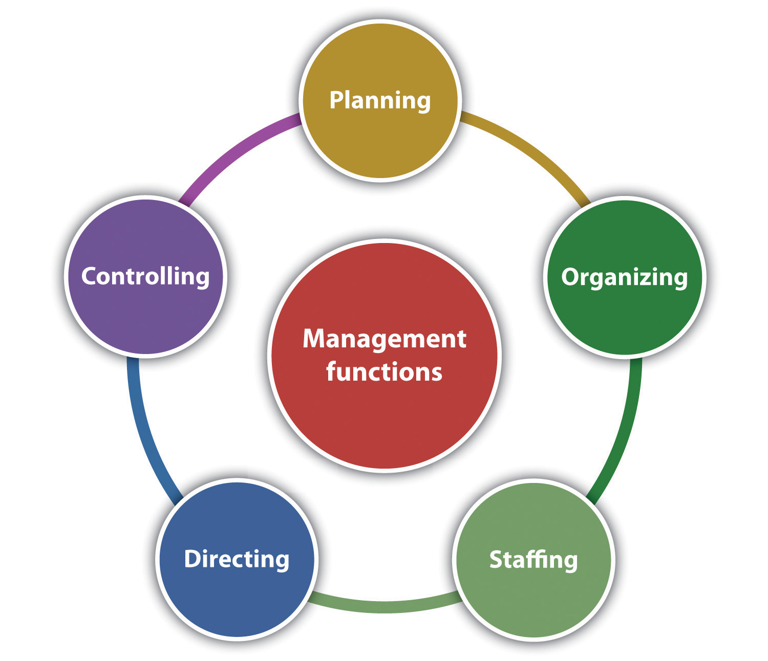

Slide 9
What are the Principles of Management?
Division of Work
Authority and Responsibility
Discipline
Unity of Command
Unity of Direction
Centralisation of authority
Scalar chain
Remuneration
Initiative

Slide 10


Slide 11
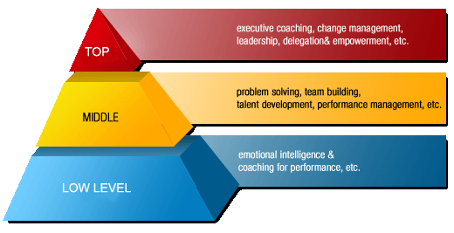
Hierarchical Management Structure
Top level management
Middle level management
Lower level management

Slide 12
Types of Industrial organization structure
The organization selects and combines the efforts of men of proper characteristics so as to produce the desired results.
Different types of industrial organization structure are as follows:
Line Organisation
Functional Organisation
Line and Staff Organisation

Slide 13
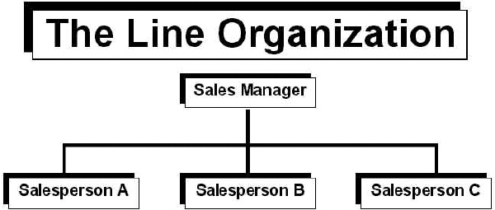
1. Line Organisation

Slide 14
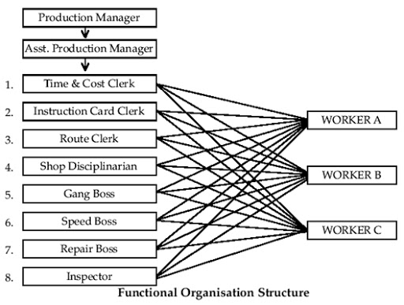
2. Functional Organisation

Slide 15
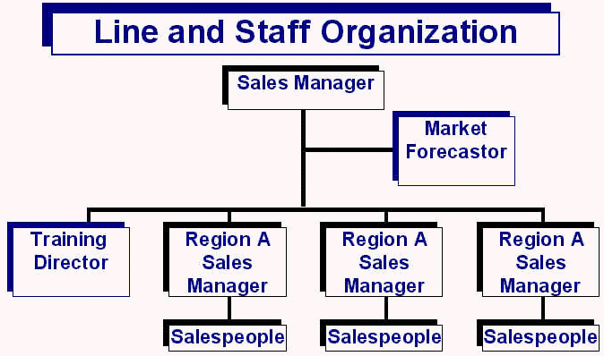
3. Line and Staff Organisation

Slide 16
Departmentation
Departmentation involves the dividing and grouping of the work to be done in an enterprise.
To perform various functions, different departments are established. These are as follows:
Personnel department
Finance department
Marketing department
Production department
Purchase department

Slide 17
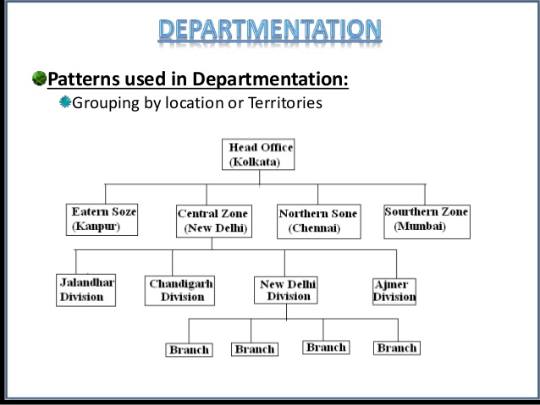

Slide 18
THANK YOU

